Slide 1
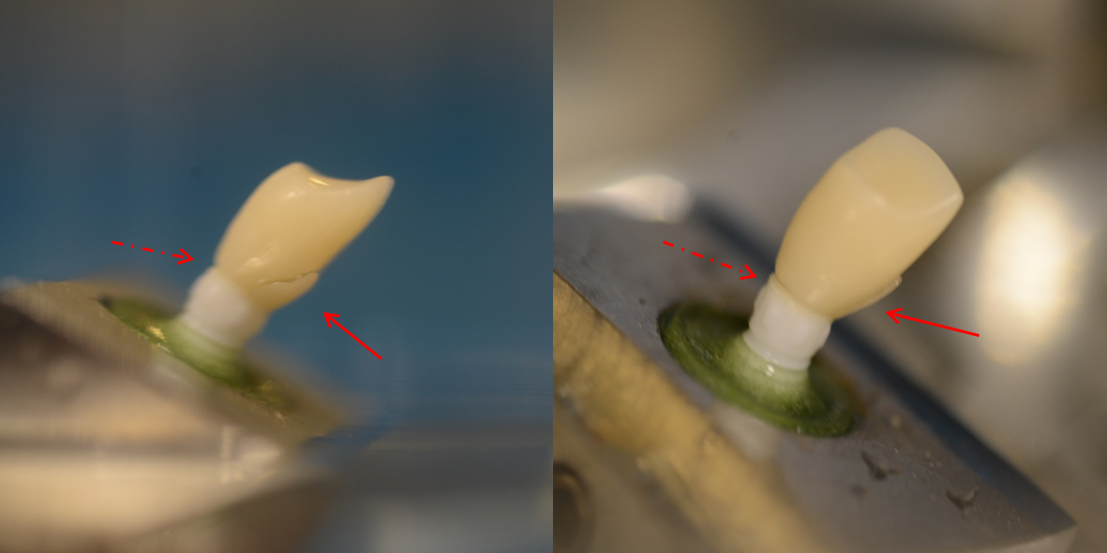
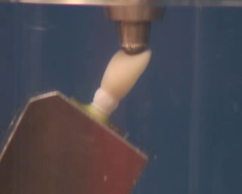
Post Fatigue Fracture Strength Test: Groups 1, C Failure Mode
Abutment bending and crown chipping

Slide 2
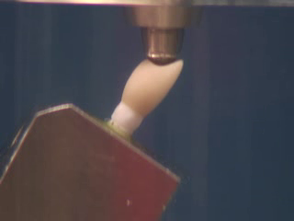
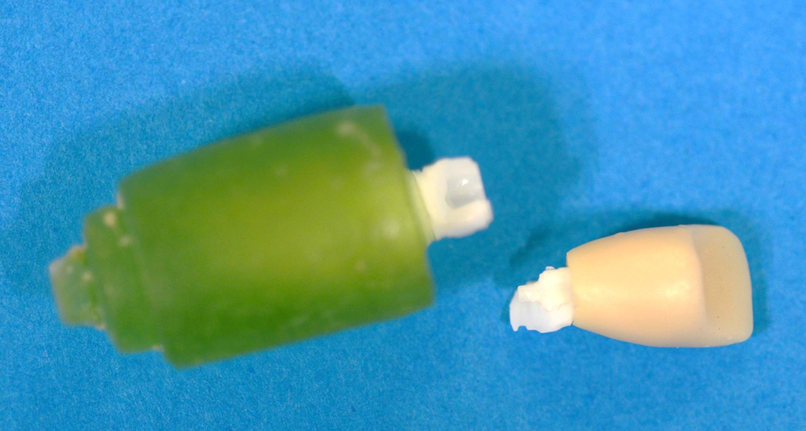
Post Fatigue Fracture Strength Test: Groups 2, H Failure Mode

Slide 3
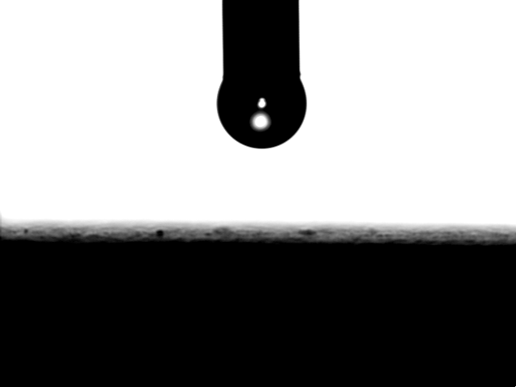
Wettability of SLActive like surface

