Slide 1
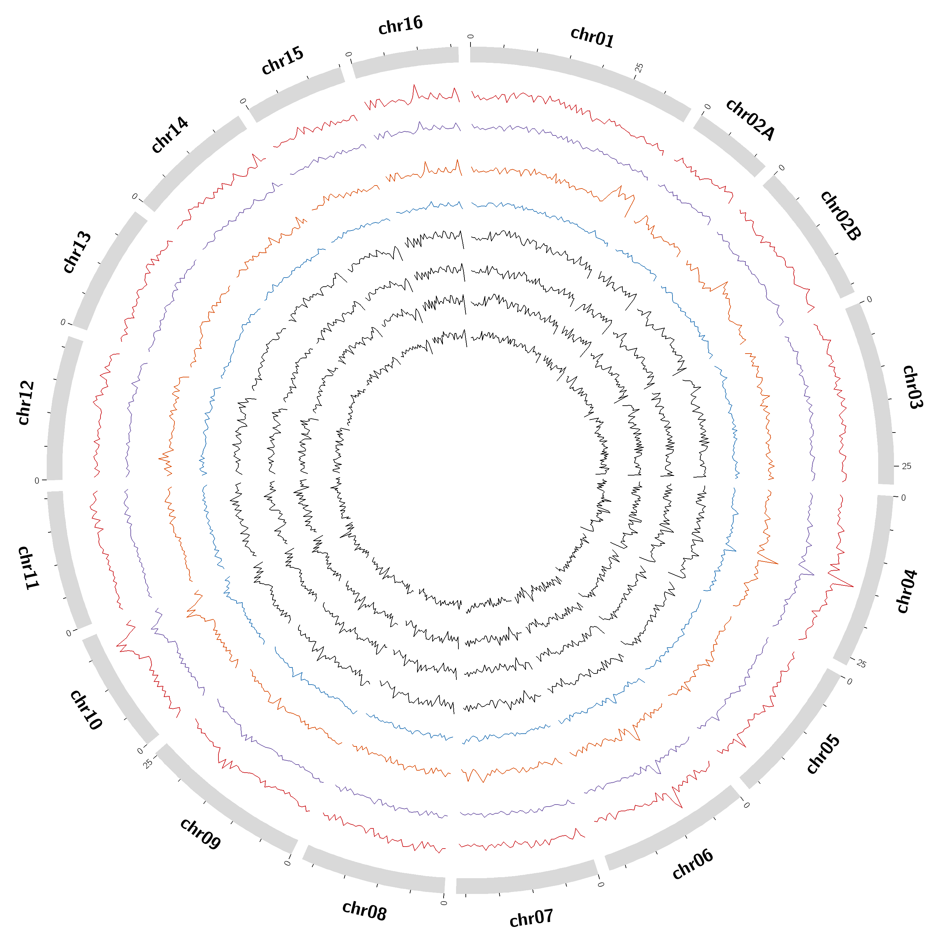
A
Supplementary Figure 8a: Density of insertions in the eight MAGIC population founder accession genomes. From the outer to inner layer is V1044371, V1044437, V1061487, V1061494, V1050446, V1060472, V1062433 and V1063769.

Slide 2
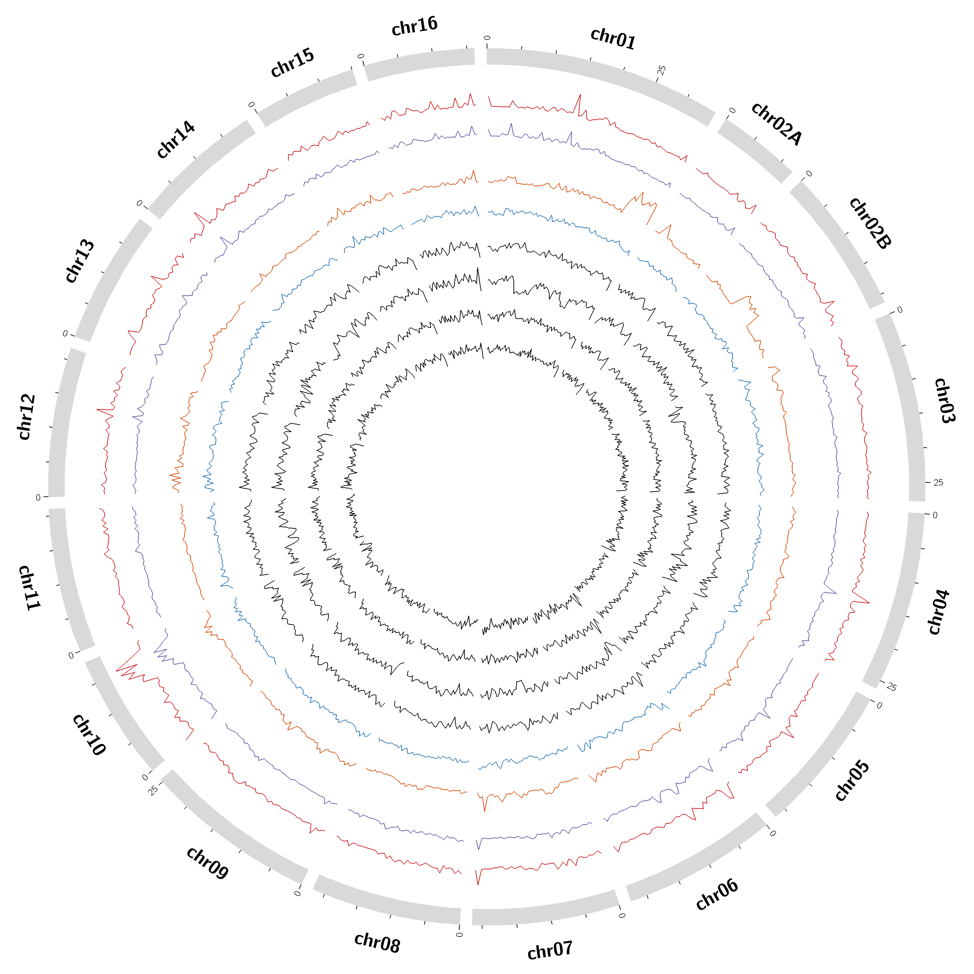
B
Supplementary Figure 8b: Density of deletions in the eight MAGIC population founder accession genomes. From the outer to inner layer is V1044371, V1044437, V1061487, V1061494, V1050446, V1060472, V1062433 and V1063769.

Slide 3
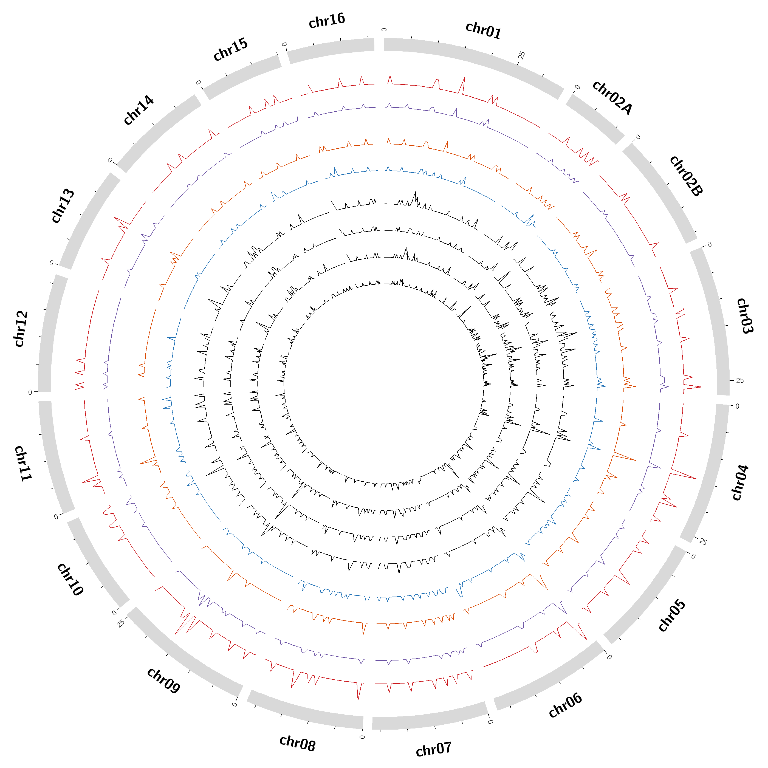
C
Supplementary Figure 8c: Density of inversions in the eight MAGIC population founder accession genomes. From the outer to inner layer is V1044371, V1044437, V1061487, V1061494, V1050446, V1060472, V1062433 and V1063769.

