Slide 1
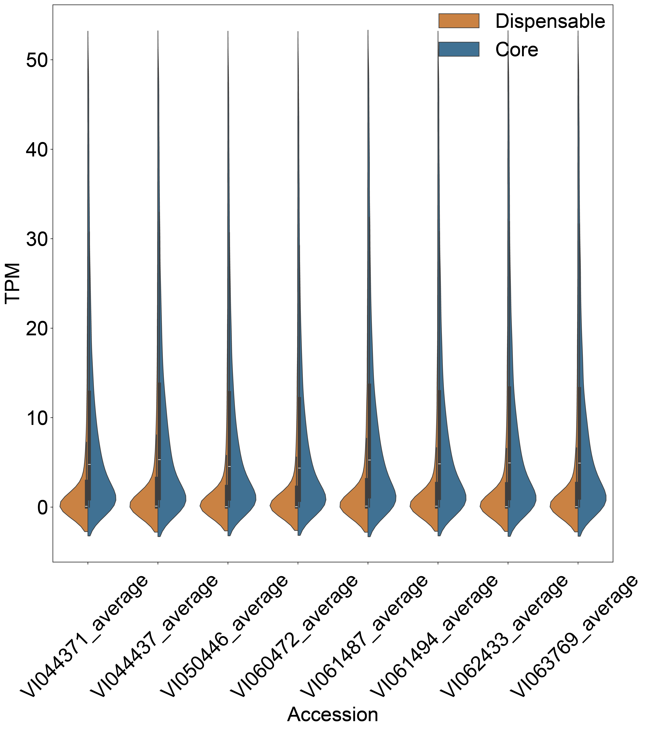
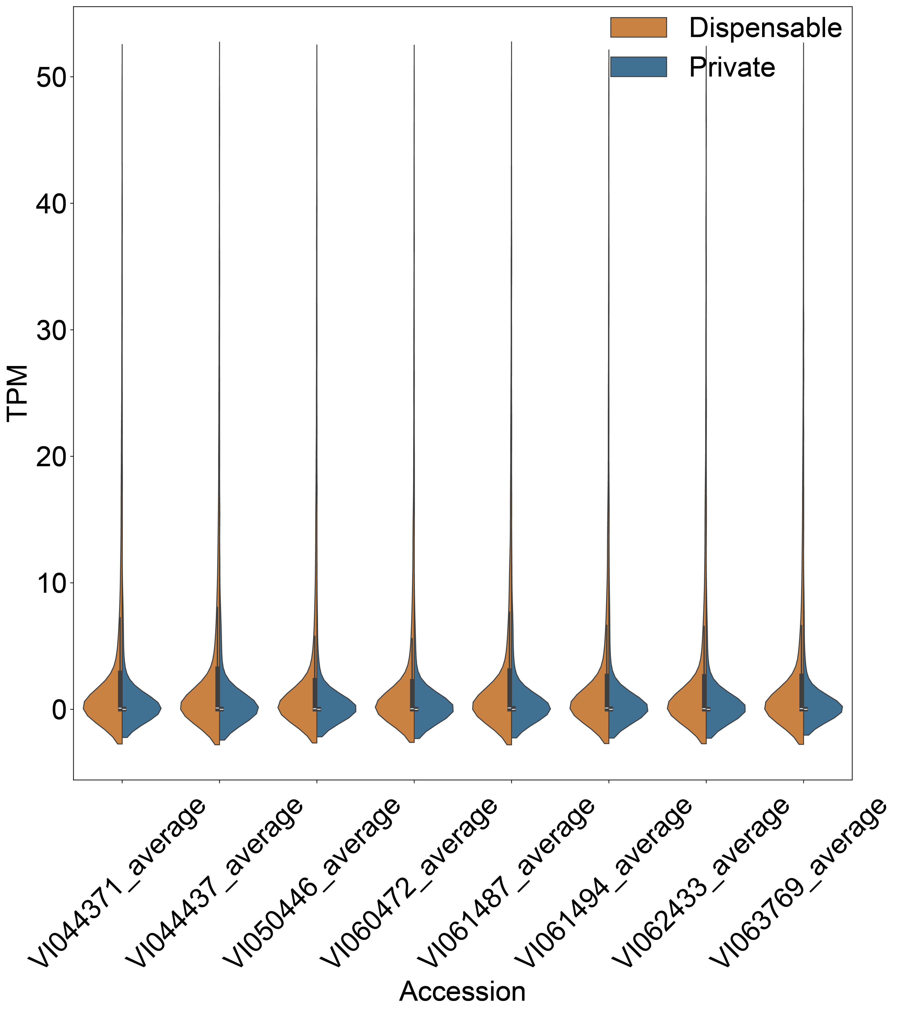
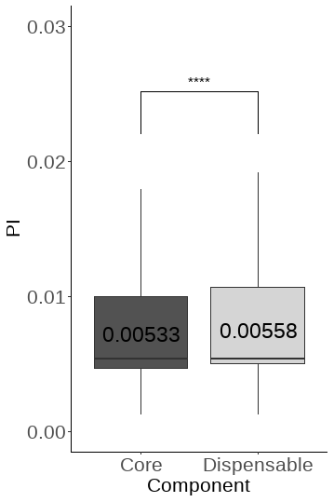
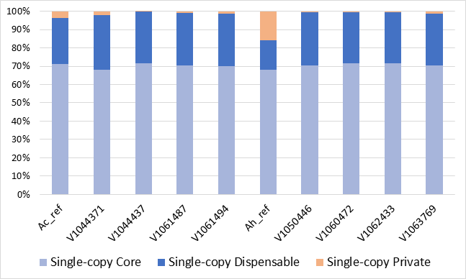
A
B
C
D
Suppl. Figure 6. Analysis of pangenome components. A, Expression of genes in different pangenome components in leaf of the 8 MAGIC population parent lines. Expression data from three biological replicates of leaf material were averaged. B, nucleotide diversity (π) within core and dispensable genes. C, proportion of single copy core, dispensable and private genes in each accession. D, proportion of BUSCO genes belonging to core, dispensable or private gene families in the pangenome.

