Slide 1
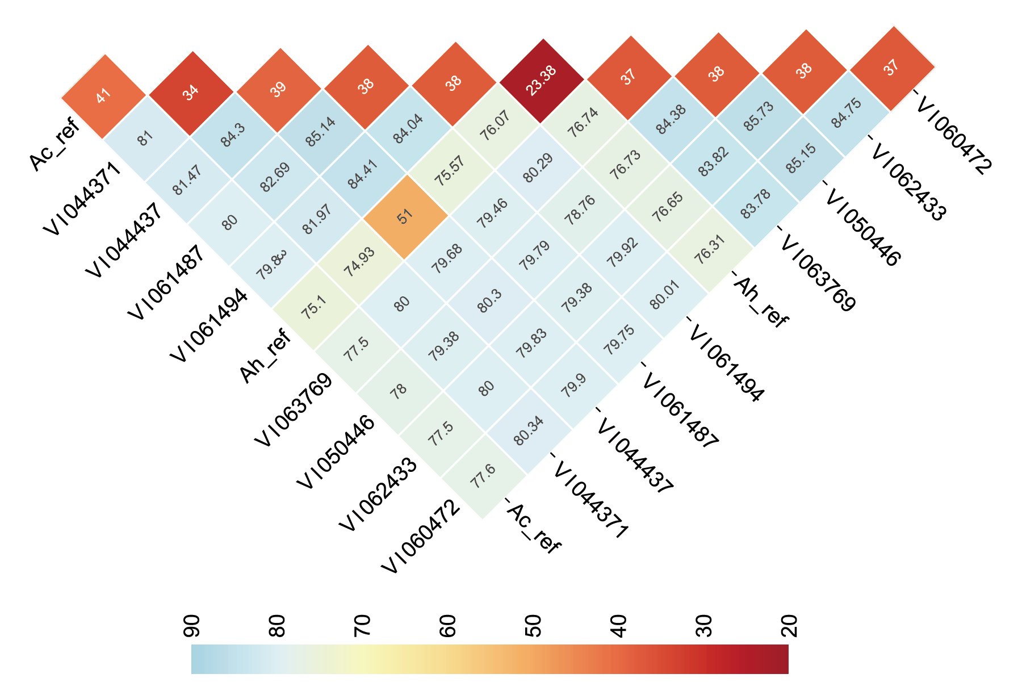
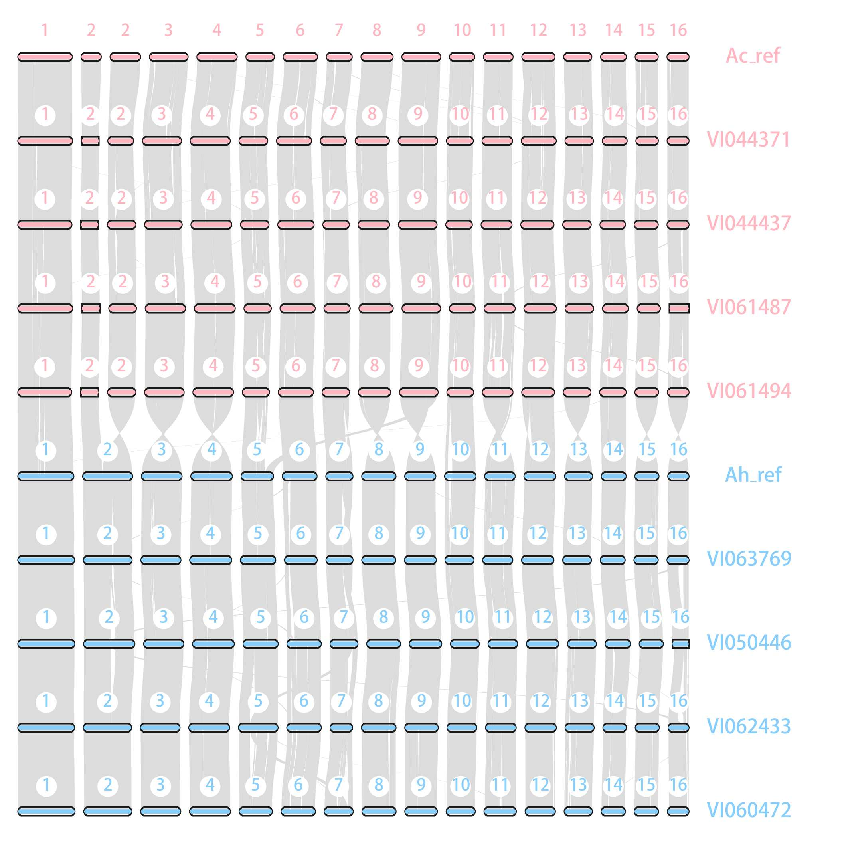
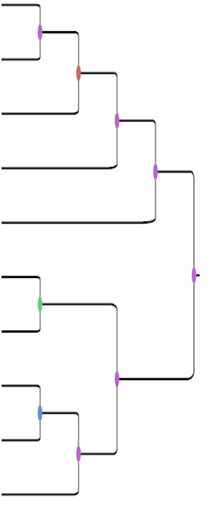
A
B
C
Supplementary Figure 5: Co-linearity and phylogenetic relationships between the eight Amaranth MAGIC population parent genomes. A) The percentage of annotated genes in collinear blocks between each pairwise genome comparison and within each genome. B) The syntenic relationships between the Amaranth genomes. Grey lines link genes showing micro-synteny. Chromosomes are numbered, with the A. cruentus genomes in pink and A. hypochondriacus genomes in blue. C) A phylogenetic tree of the relationships between species based on 5534 single-copy genes. Ac_ref indicates the updated annotation of the A. cruentus reference genome and Ah_ref indicates the published A. hypochondriacus genome (Lightfoot et al. 2017).

