Slide 1
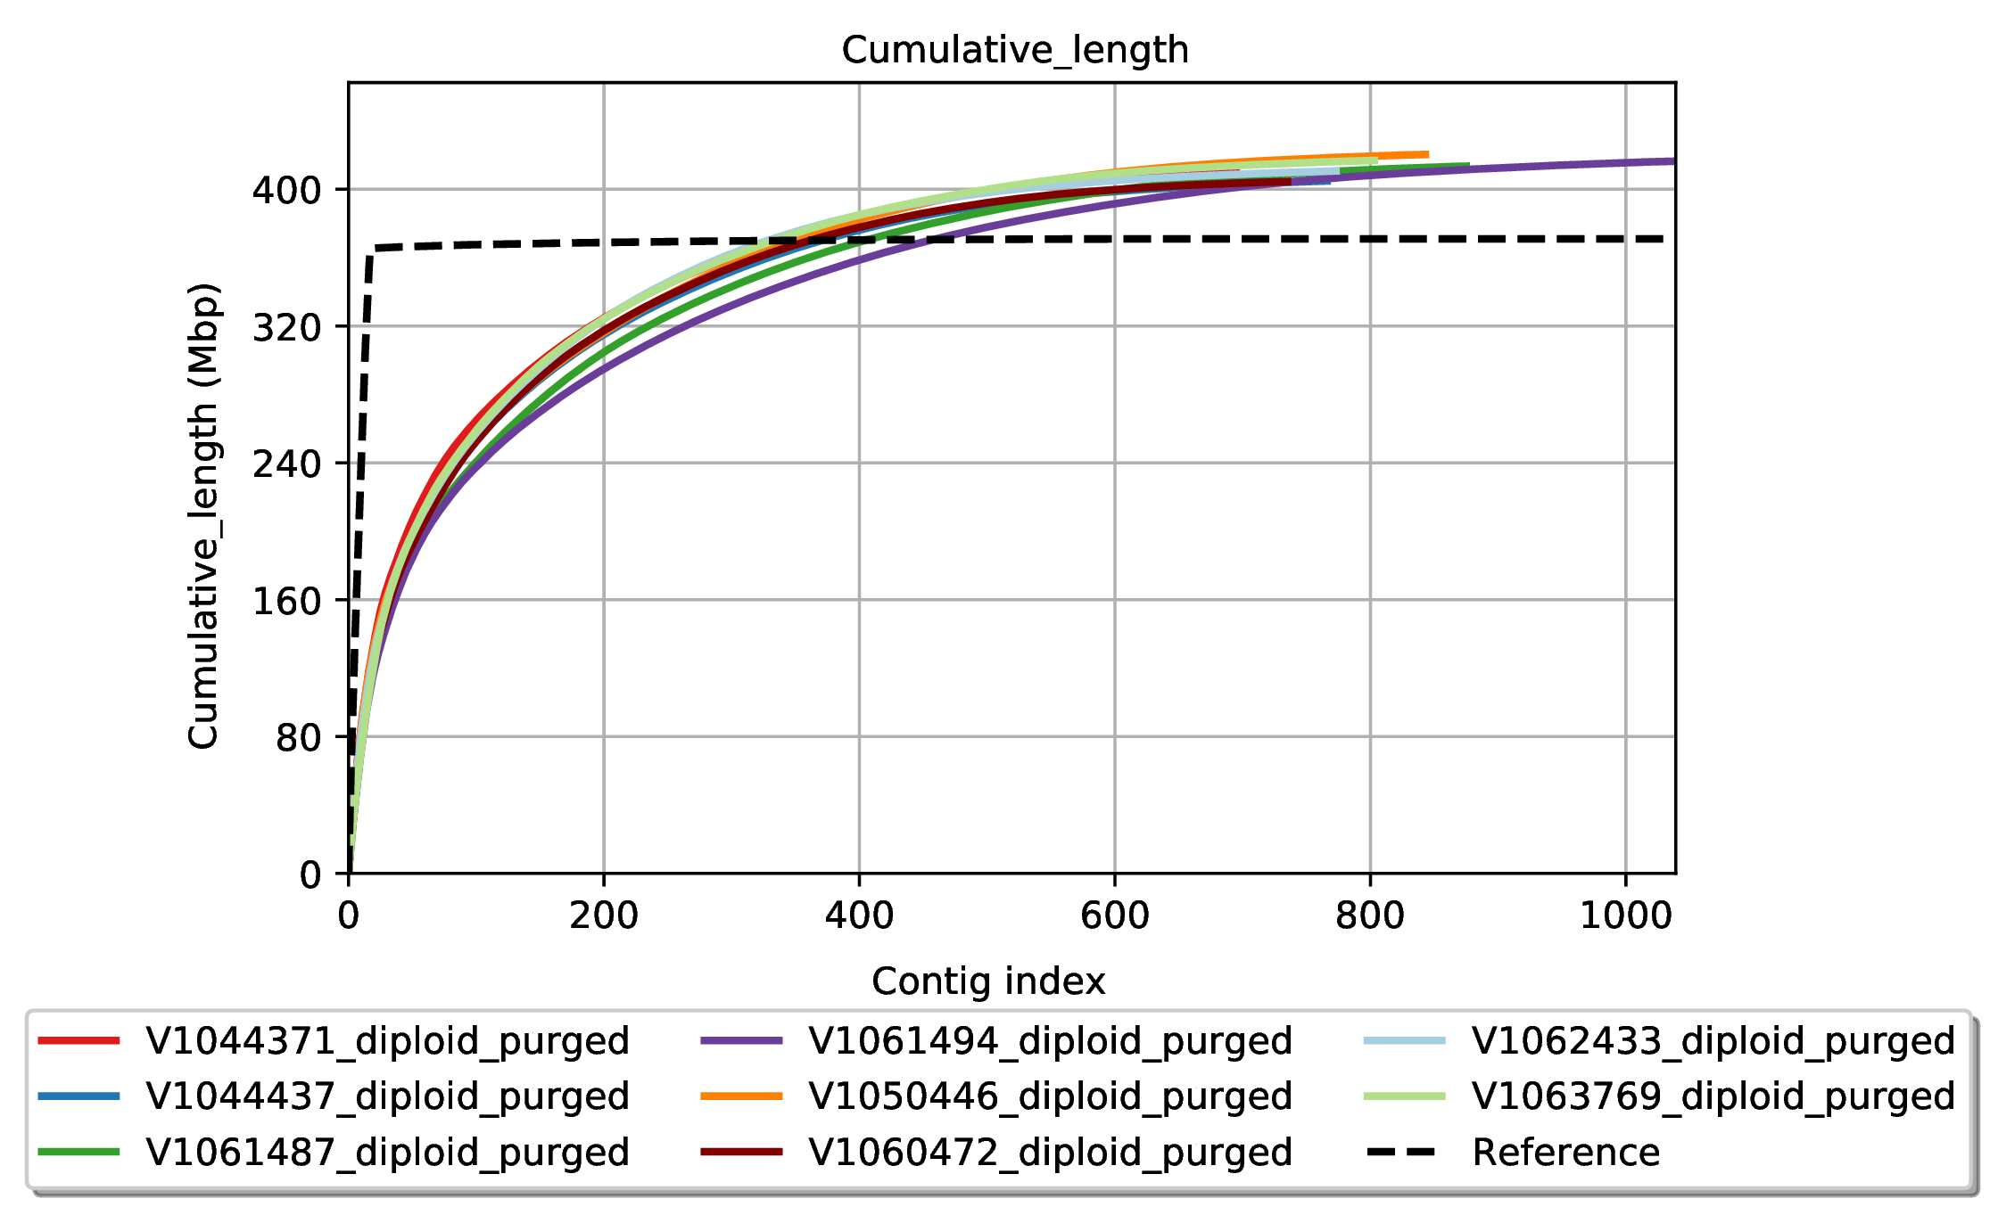
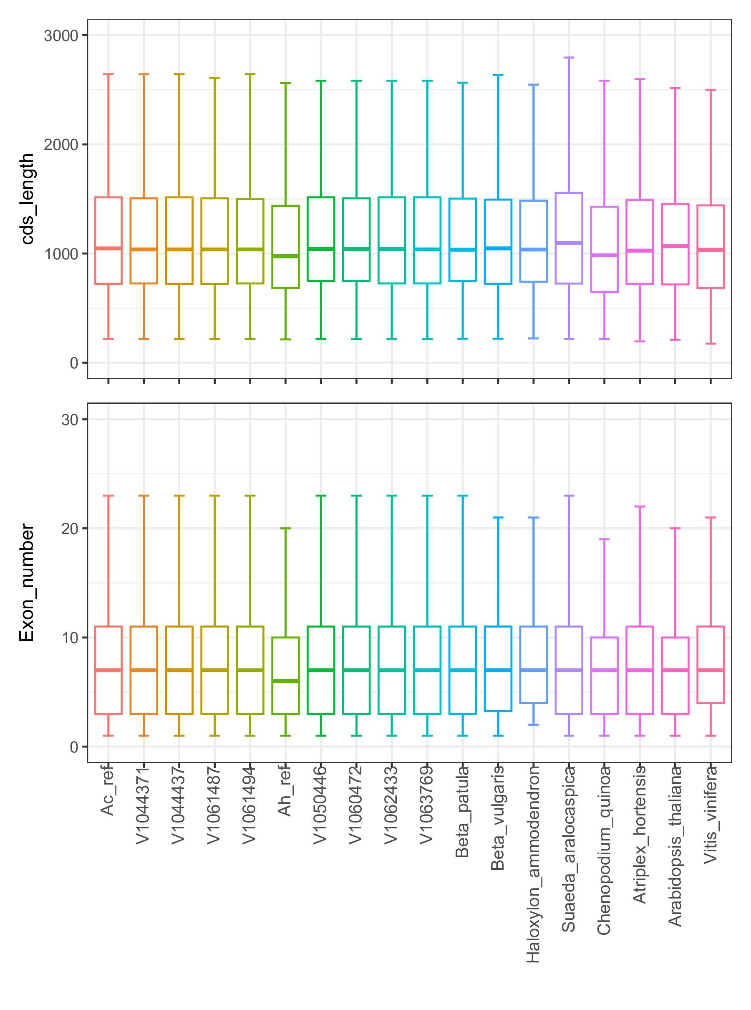
A
B
Supplementary Figure 4: Amaranthus MAGIC population parent accession genome assembly and annotation. A) The cumulative length of all eight assemblies by number of contigs compared to the reference A. cruentus (Ma et al. 2021). B) Comparison of average coding sequence length and exon number between 10 Amaranthus genomes, 6 other species from the Amaranthaceae family plus Arabidopsis thaliana and Vitis vinifera.

