Slide 1
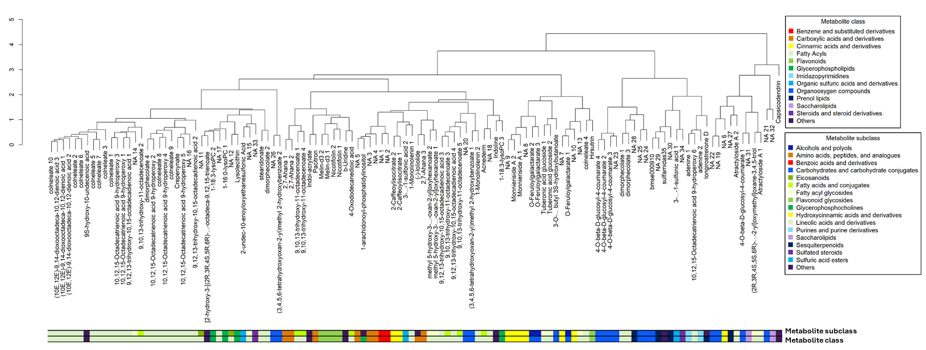
Supplementary Figure 3: Clustering of 122 annotated metabolites on their abundance across samples from the 8 Amaranth MAGIC population founder lines.

