Slide 1
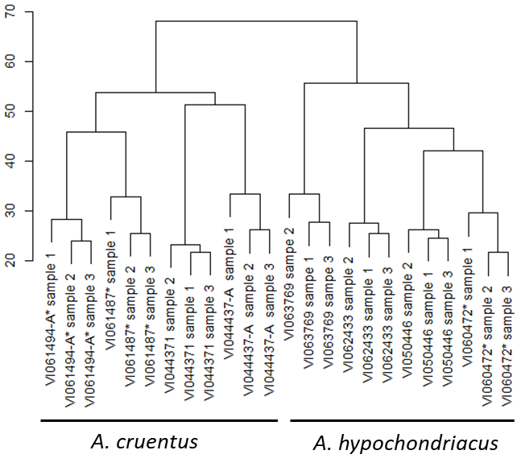
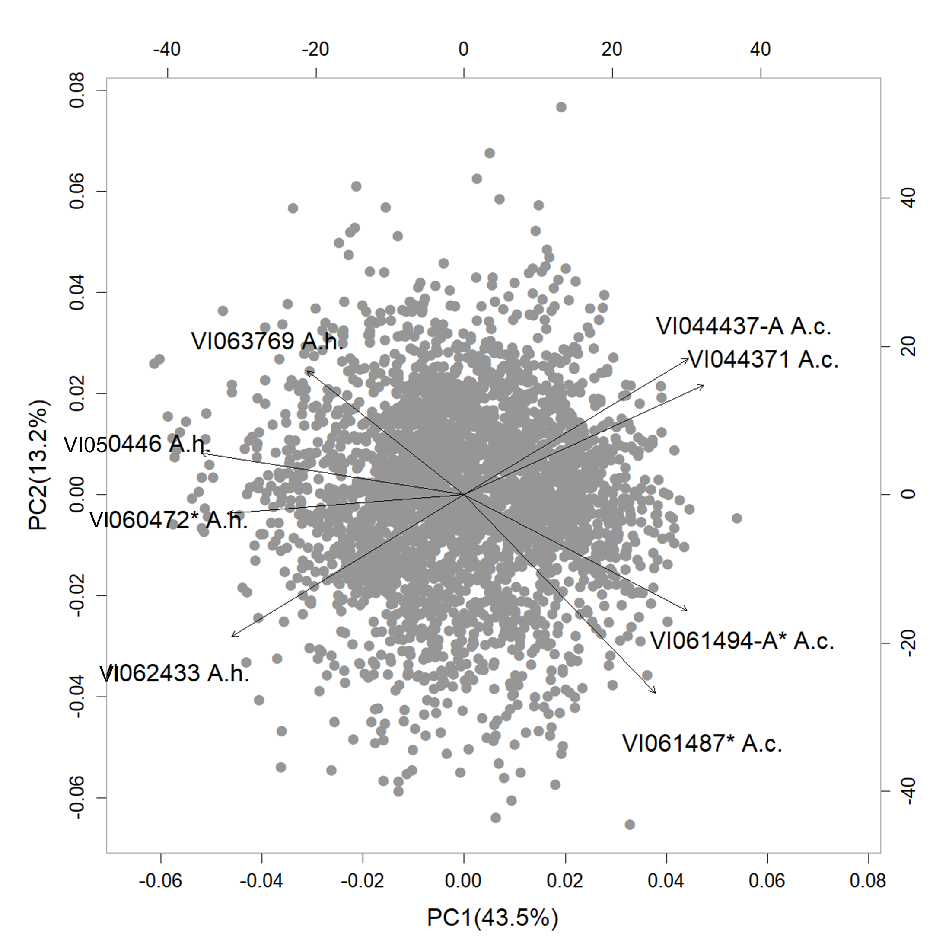
A
B
Supplementary Figure 2. Accession and metabolite sample clustering based on normalised data for 3259 non-redundant detected features. A) Hierarchical clustering dendrogram revealing similarity between biological replicate samples as well as differences between the two species. B) A bi-plot demonstrating clear separation of the two species groups based on principal component analysis of the metabolites.

