Slide 1
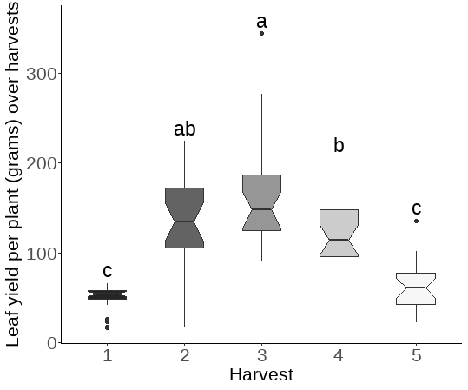
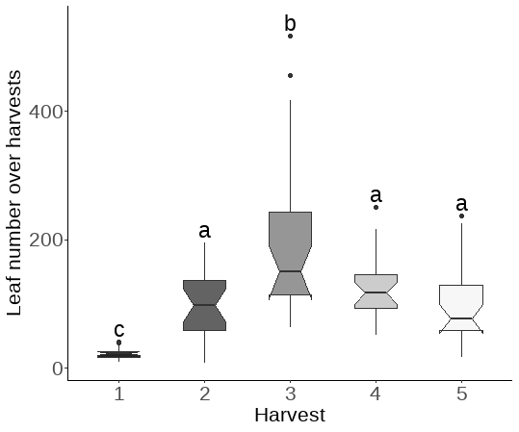
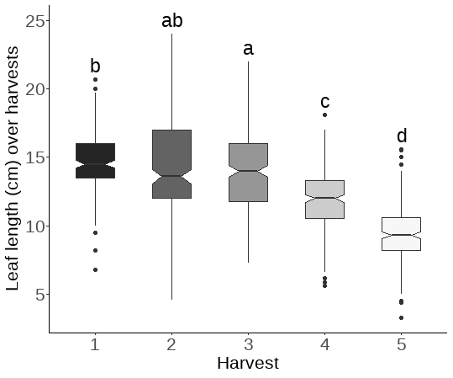
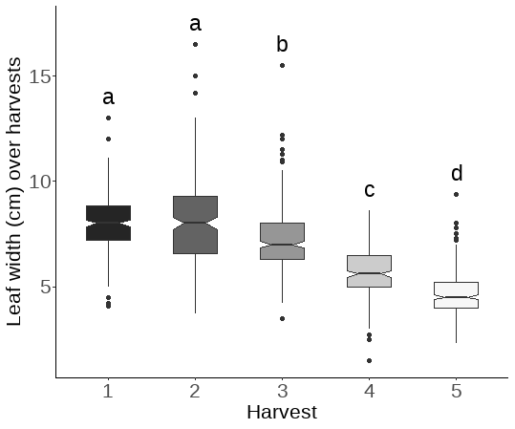
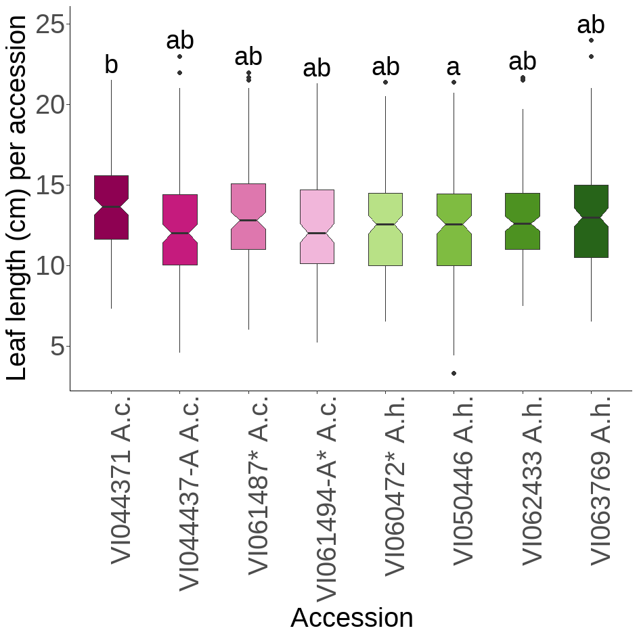
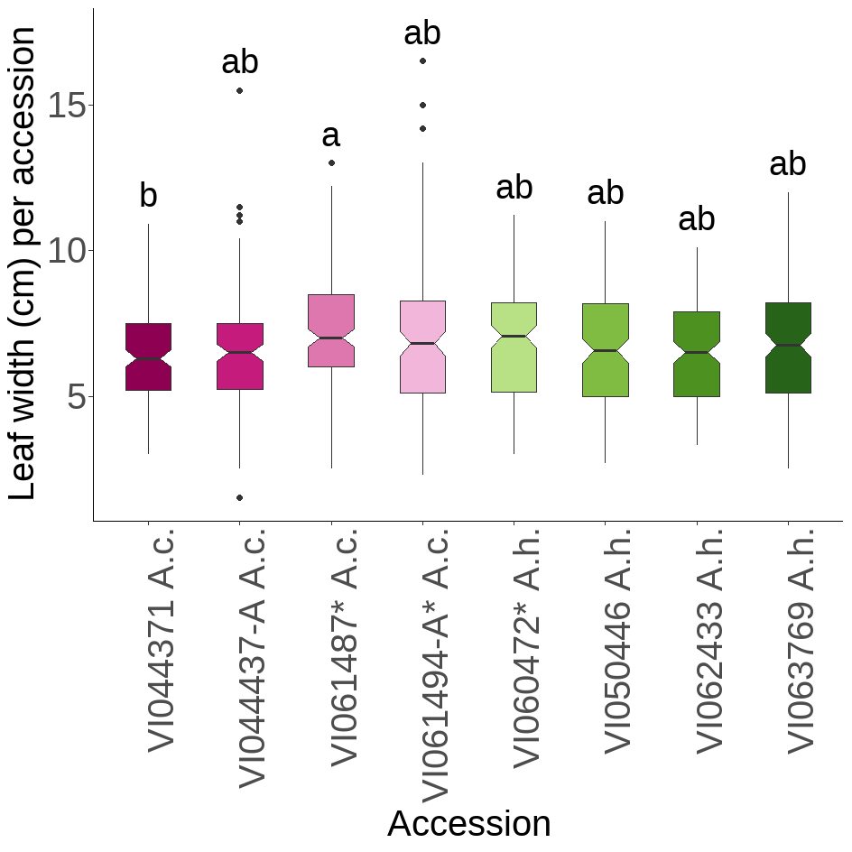
A
B
C
D
E
F
Supplementary Figure 1. Leaf trait data from the irrigated field trial of the eight MAGIC parent accessions. Box plots showing the median and interquartile range of A) leaf yield per plant at five different harvests (N = 120), B) number of leaves per harvest (N = 120), C) leaf length and D) leaf width at each harvest (N = 1200), E) leaf length and F) leaf width per accession over all harvests (N = 1200). Tukey’s test letter codes indicate significance (p < 0.05) between the boxplots. ‘*’ by accession IDs indicates the accessions showing genomic admixture.

