Slide 1
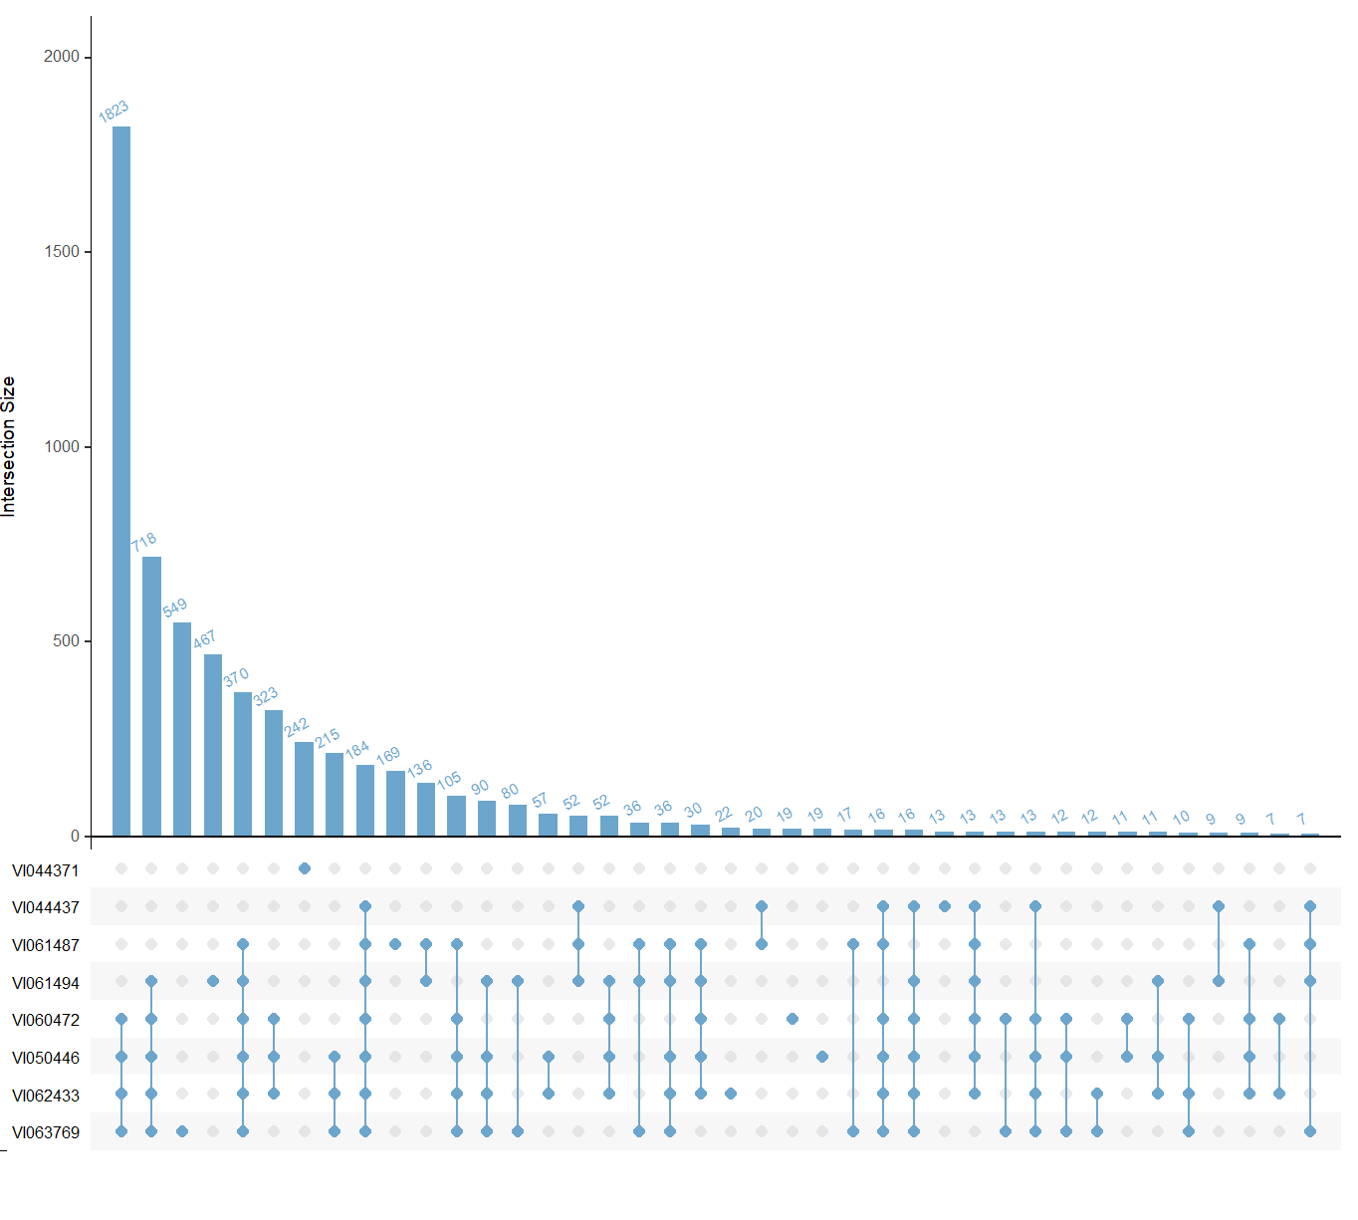
A
Accession | # of genes in deleted regions, or containing deletions, compared to A. cruentus reference
V1044371 | 242
V1044437 | 382
V1061487* | 1249
V1061494* | 2370
V1050446 | 4166
V1060472* | 3797
V1062433 | 4180
V1063769 | 4374
B
Suppl. Figure 9. Genes contained within deletion regions (or containing deleted regions) of the MAGIC parent genomes compared to the A. cruentus reference genome. A) The number of genes within or containing deletions in each MAGIC parent line. B) The overlap of genes within or containing deletions across the MAGIC parent lines.

