Slide 1
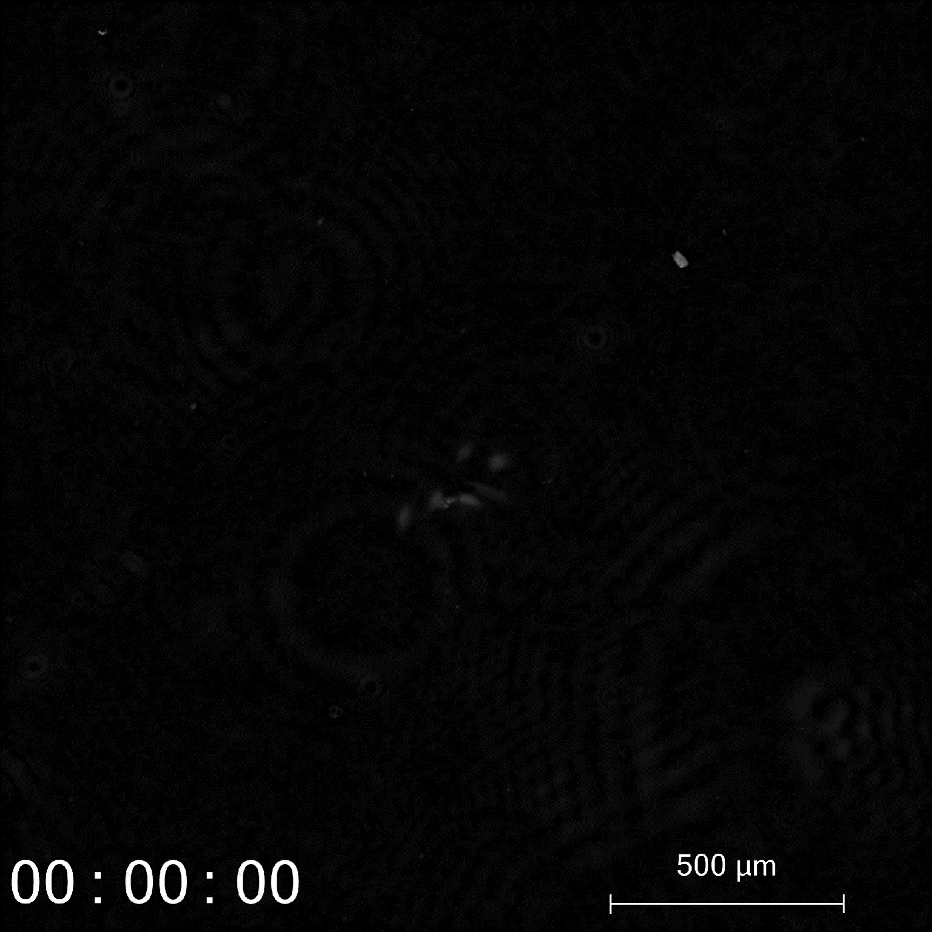
Supplementary Video 1. Ptychographic imaging Y202 cells tracked for 96h in Y202CM

Slide 2
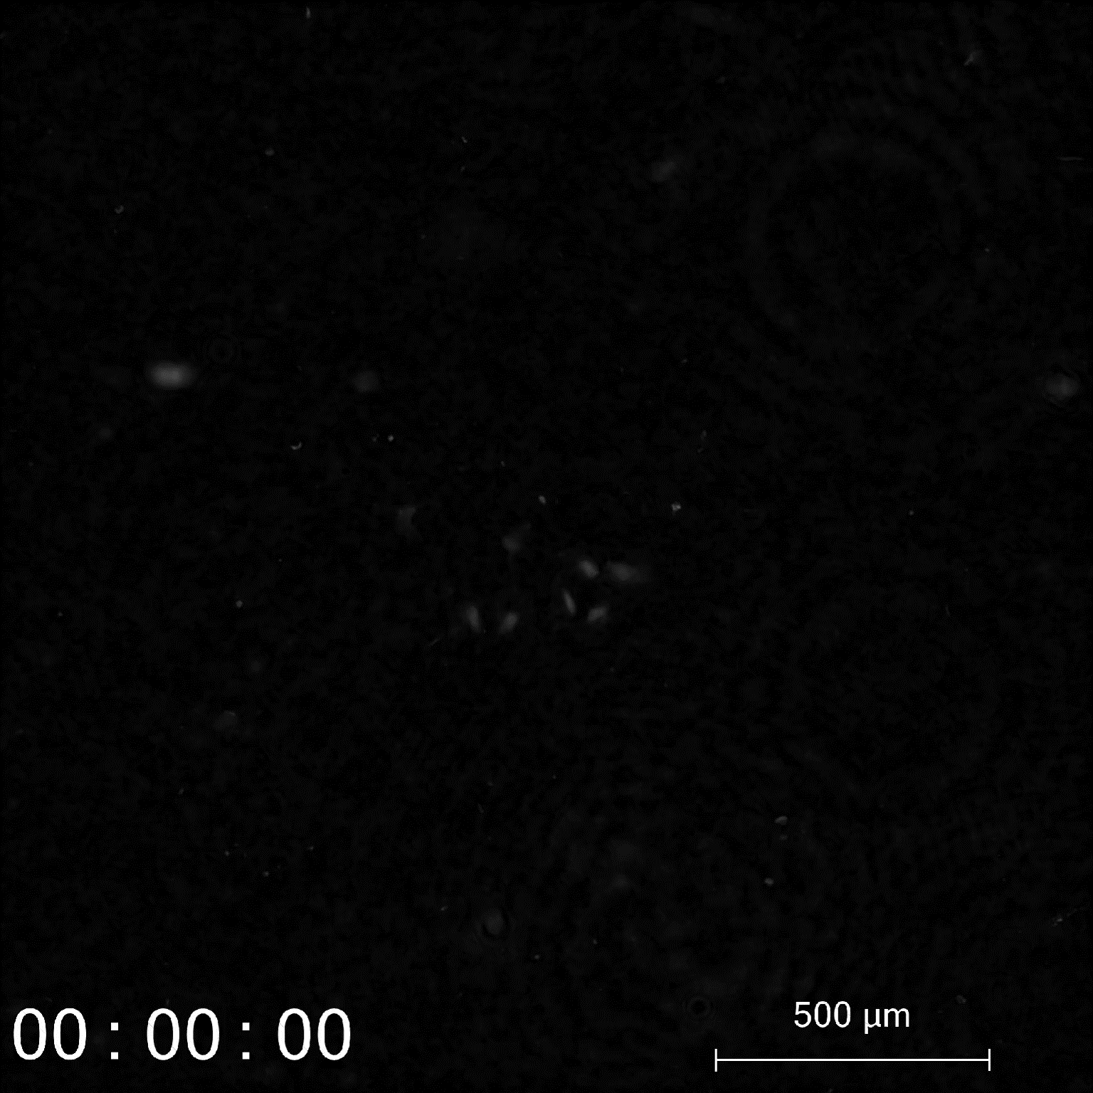
Supplementary Video 2. Ptychographic imaging of Y202 colony tracked for 96h in Y201CM

Slide 3
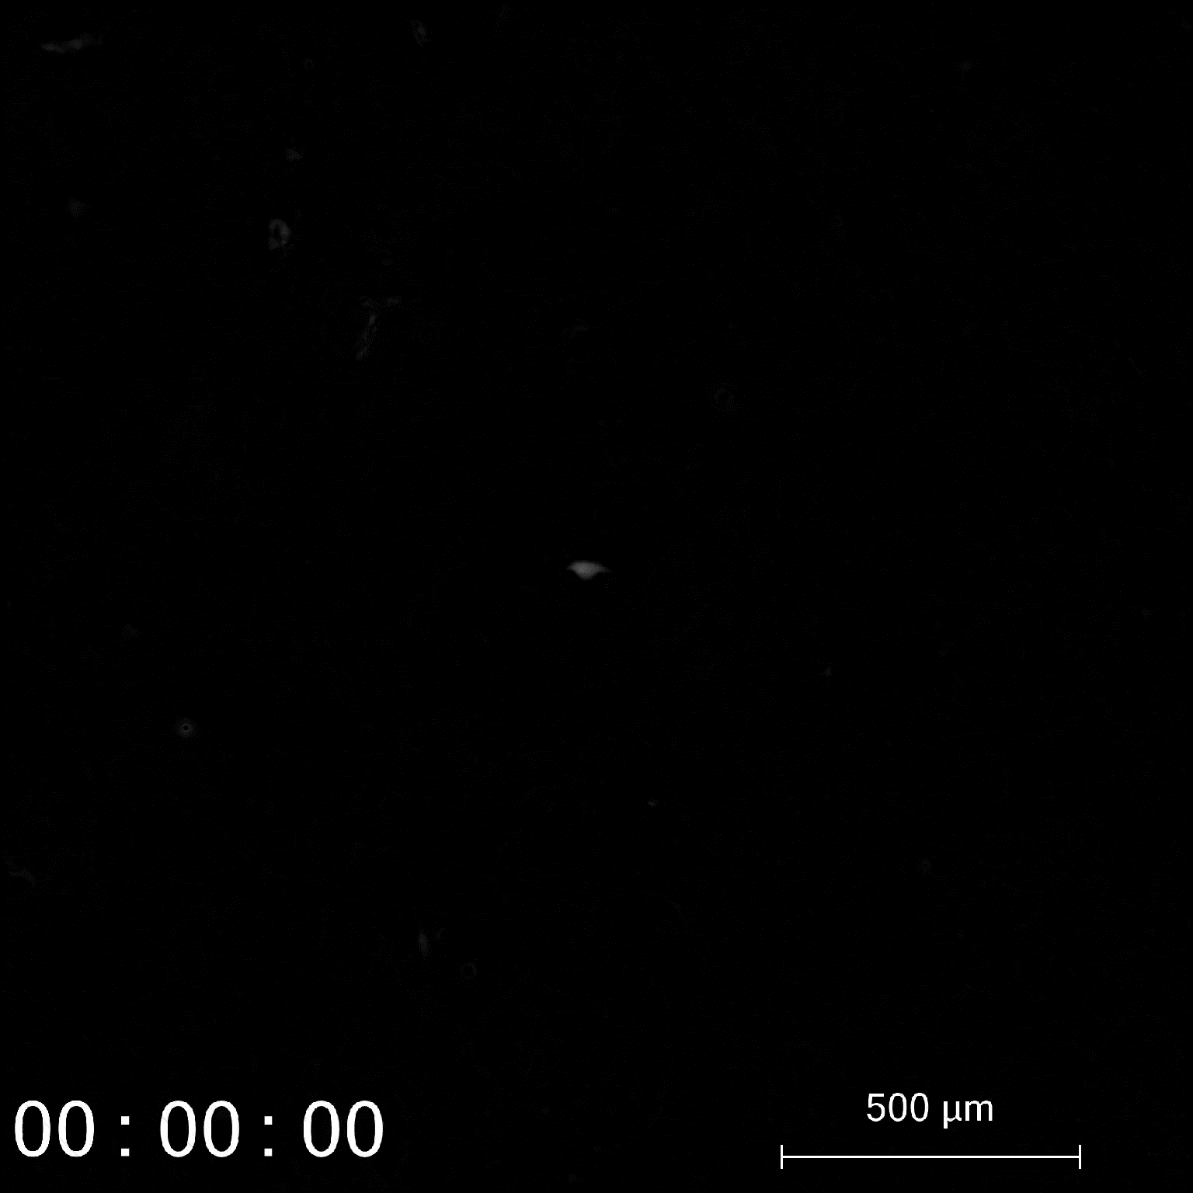
Supplementary Video 3. Ptychographic imaging of Y202 cells tracked for 96h after seeding onto plastic

Slide 4
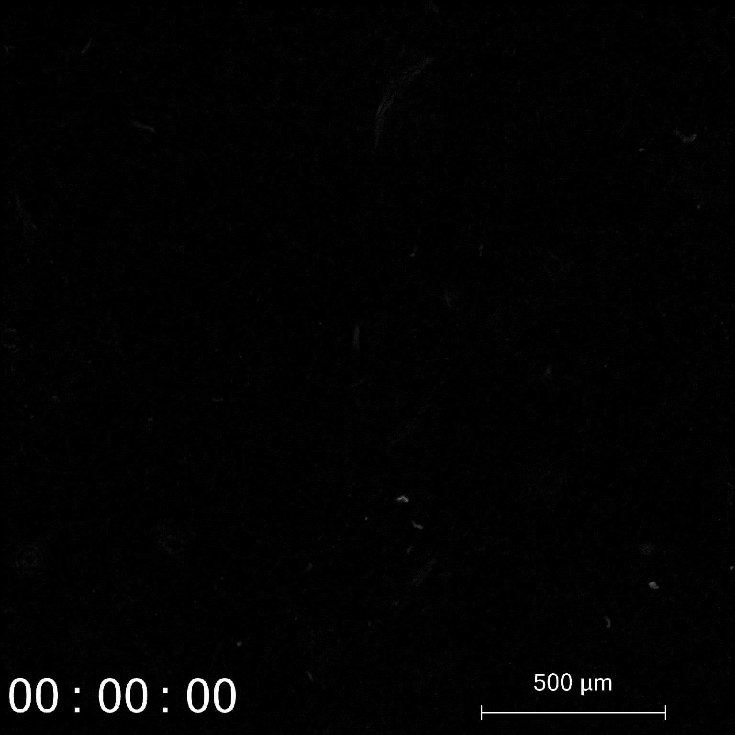
Supplementary Video 4. Y202 cells tracked for 96h after seeding onto Y201 derived ECM

