Slide 1
Appendix 3.1

Slide 2
Appendix 3.1. The effects of ELF3 overexpression on wound healing in primary matched pair samples.
Two primary prostate cancer/normal matched pair samples were transduced with lentivirus (control, ELF3-WT and ELF3-ΔAT). Cells were plated into wells with ibidi wound inserts and left to adhere overnight. The following day the inserts were removed and the cells were imaged and tracked using a VL21 microscope. Each condition was carried out in triplicate with three regions of interest (ROI) in each. Each colour indicates a well and each box within a colour indicates an individual ROI. NB: Sample H681/17 L does not have a control transduced condition as the culture became infected. In sample H681/17 R, ROI 3 of well B2 was not useable.
Data and videos were generated by Mandy Noble using Catbox software and analysed by myself.

Slide 3
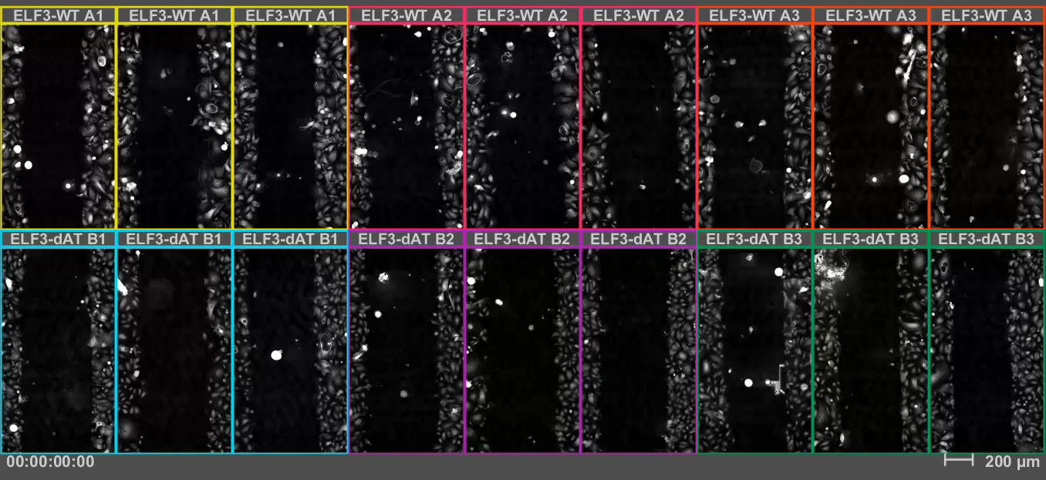
H681-17 L (Cancer)

Slide 4
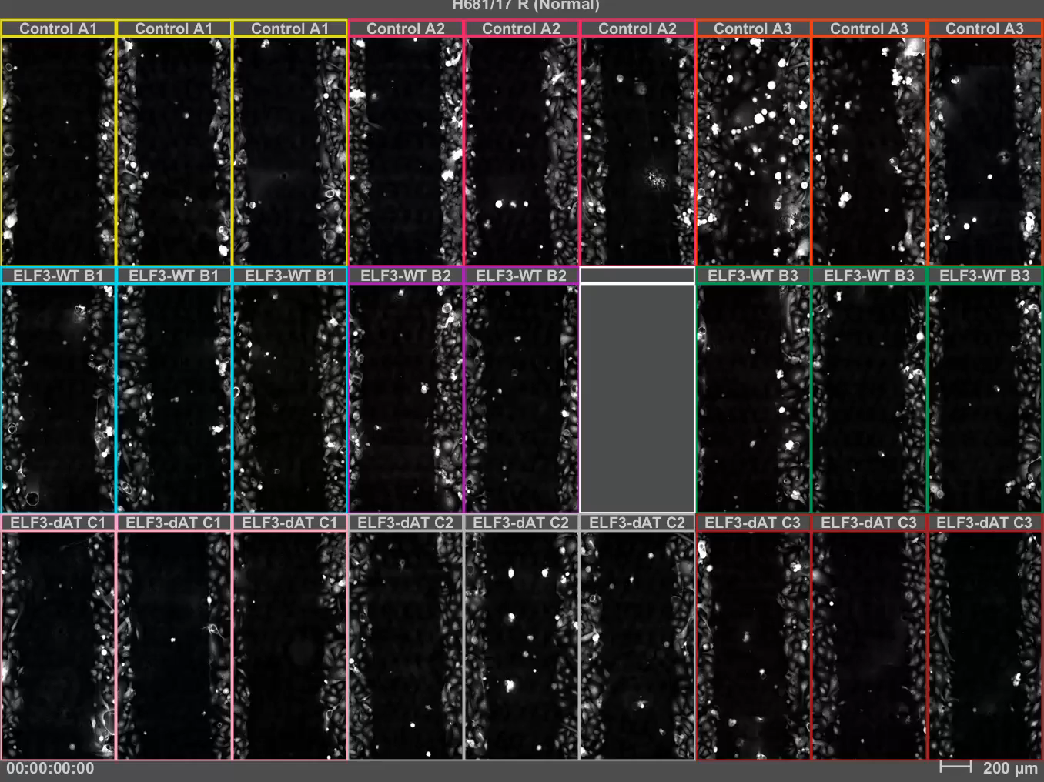
H681-17 R (Normal)

Slide 5
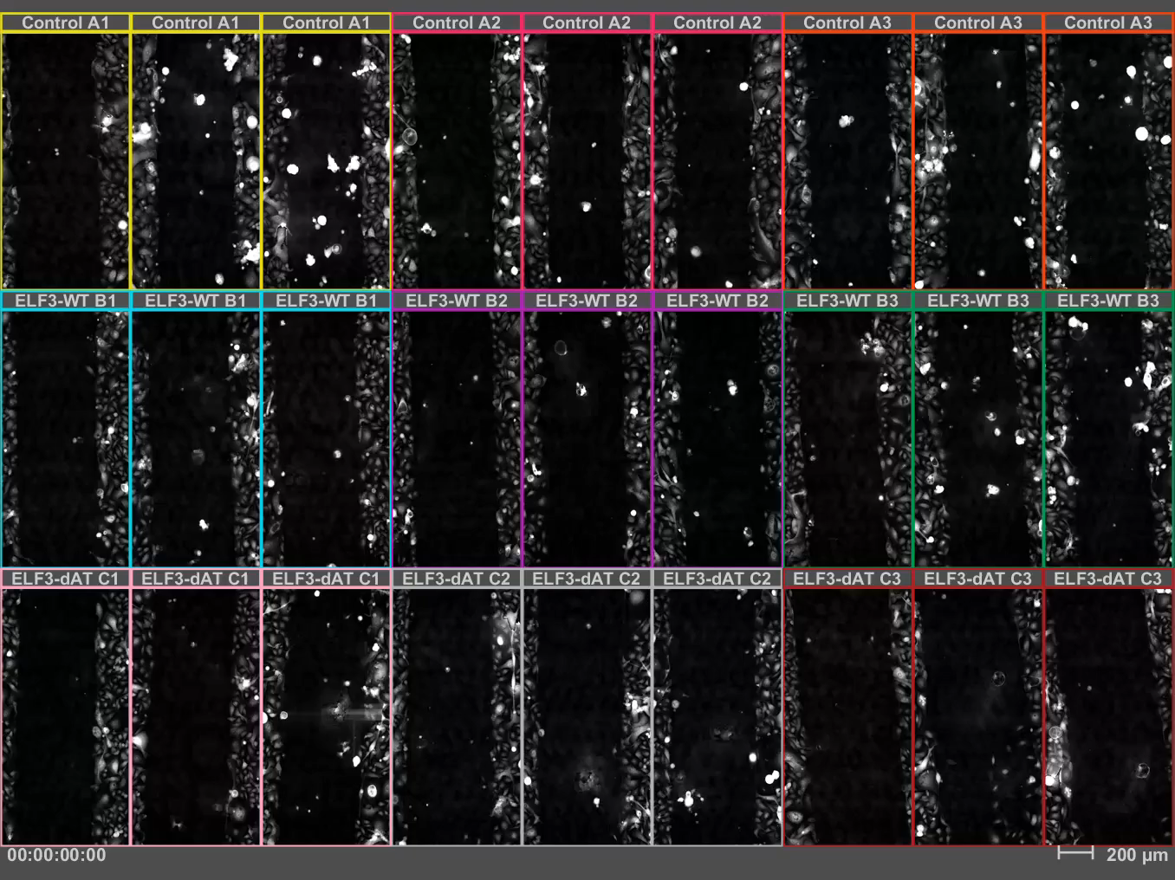
H682-17 L (Cancer)

Slide 6
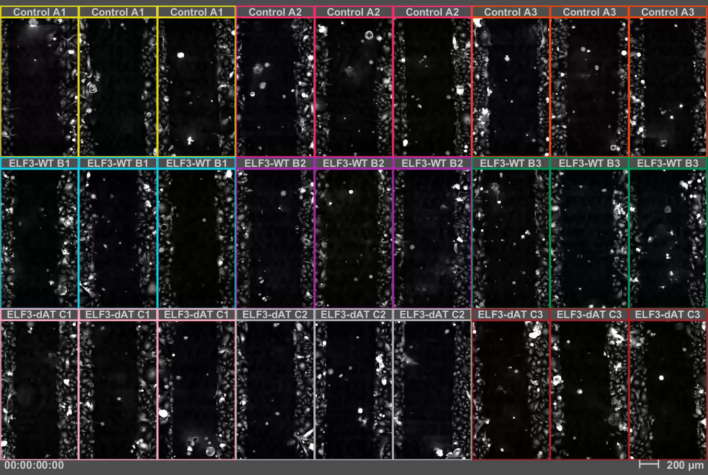
H682-17 R (Normal)

