Slide 1
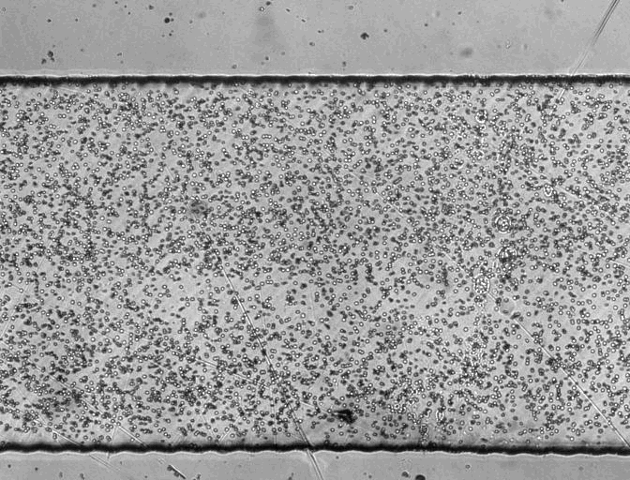
A.1: Red blood cells, 1 mW applied power, pDEP

Slide 2
A.2: 1 µm latex beads, 1 mW applied power, nDEP

Slide 3
A.3: DPSCs, 1 mW applied power, pDEP, 9.5-10.5 MHz

Slide 4
A.4: DPSCs, 1 mW applied power (slowed x4), live and dead separation

